Slide 1
APC Training for PCLDPE
Production Team Training Module
17th & 21st June 2021
Internal

Slide 2
Content
01.
02.
03.
04.
05.
06.
APC Overview
PCLDPE APC Overview
Main Controlled Variables
APC/ DCS Internal Logic
Inferential Qualities
Grade Transition Manager
03
09
15
26
32
40
Internal

Slide 3
APC Overview
Insert subtitles here
Internal

Slide 4
APC Overview
What is APC?
Advanced Process Control (APC) is an application with some features
• Multivariable – controls many variables in a single MPC controller
• Predictive - uses historical data to predict current and future state
• Control – calculates moves to be made to bring the process to desired condition and sends signals to regulatory controllers.
• Model-based – models describe interactions of variables in the APC envelope.
• Has optimization capability in which economic objectives can be achieved by MPC controller by maximizing or minimizing desired variables or keep them at preferred values.
Internal

Slide 5
APC Overview
Basic Terminologies:
Independent Variable – Manipulated Variable (MV) – Disturbance Variable/Feedforward Variable (DV/FF)
Dependent Variable – Controlled Variable (CV)
There are 2 types of APC:
Linear APC to handle linear processes
Most of APCs used in PETRONAS are linear. (SMOC, RMPCT, DMC+)
Concepts of :
o Preservation of scale
o Superposition
2. Non-linear APC • Used in PETLIN and MTBE
Internal

Slide 6
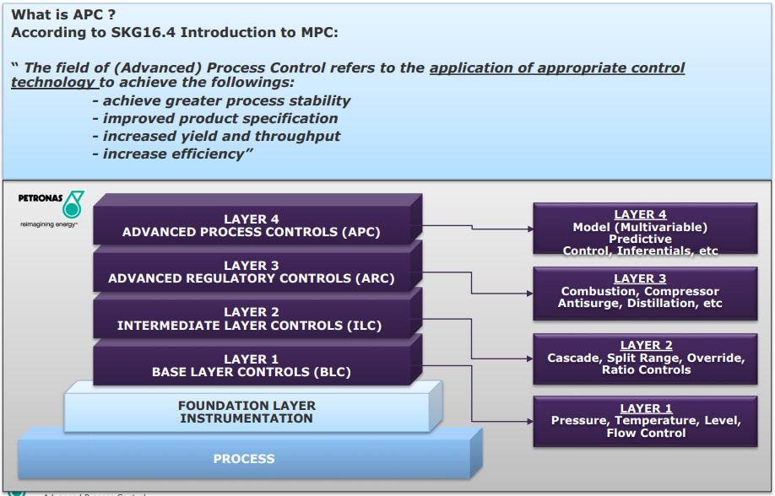
APC Overview
Internal

Slide 7
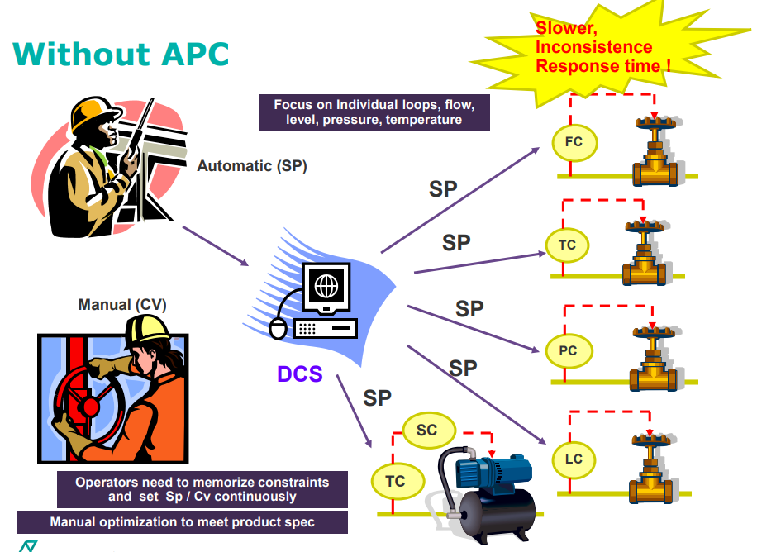
Internal

Slide 8
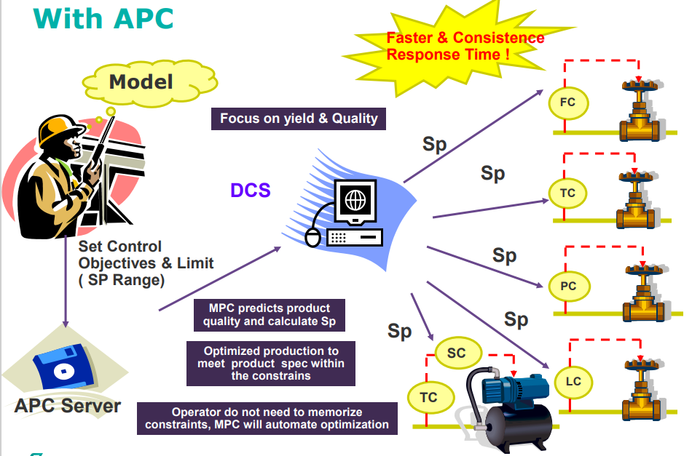
Internal

Slide 9
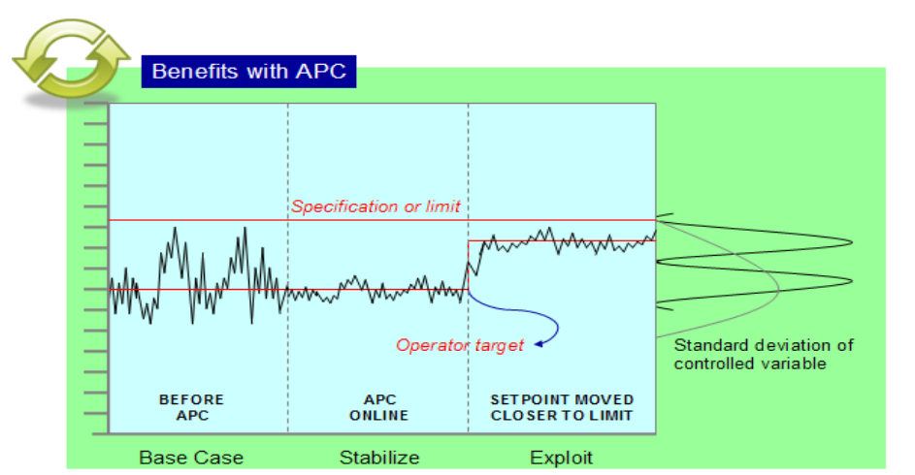
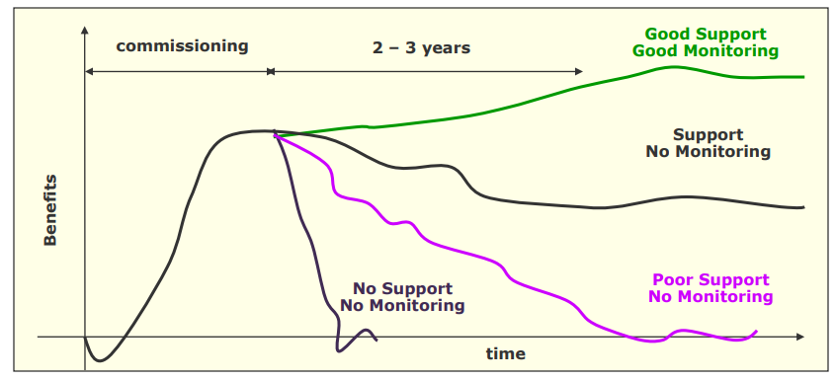
Benefits with APC
Internal

Slide 10
PCLDPE APC Overview
Internal

Slide 11
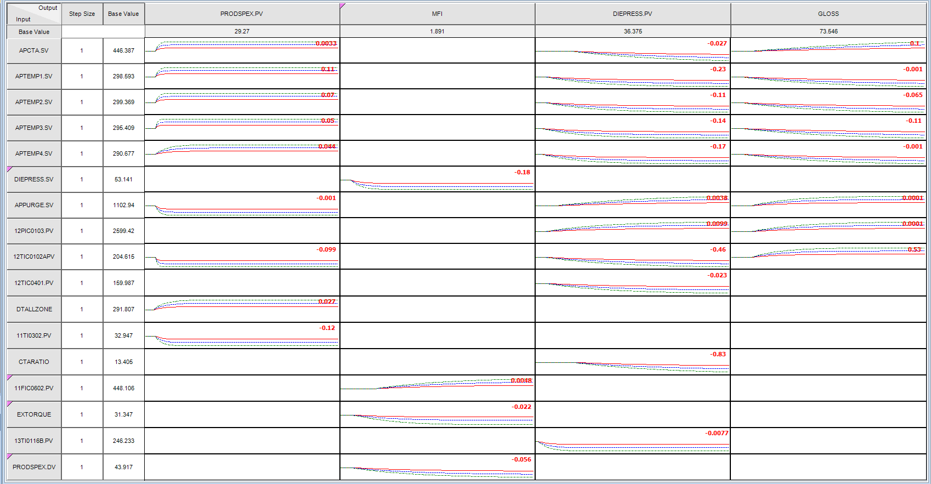
PCLDPE APC Overview
How APC know , what MVs to be moved and how much to be moved?
There is relationship between all MVs with the CVs ,and it is called APC model.
Internal

Slide 12
PCLDPE APC Overview
Advanced Process Control application was implemented in PCLDPE in order to achieve several objectives as below:
Minimize variance in MFI and Gloss during steady state operation
Minimize transition times by automating transitions
Maximizing production rate without compromising quality
Minimizing purge gas without compromising quality subject to constraints
These objectives can be achieved by having few APC components which are:
Polymer Inferential Properties (Aspen IQ)
Non-Linear Advanced Process Control
Process Recipe and Transition Manager (Grade Transition Manager)
Internal

Slide 13
PCLDPE APC Overview
No | Model Tag | DCS Point | Description
1 | APCTA.SV | APCTA.RSV | Propylene Flow
2 | APTEMP1.SV | APTEMP1.RSV | Peak Temp Zone 1
3 | APTEMP2.SV | APTEMP2.RSV | Peak Temp Zone 2
4 | APTEMP3.SV | APTEMP3.RSV | Peak Temp Zone 3
5 | APTEMP4.SV | APTEMP4.RSV | Peak Temp Zone 4
6 | APPURGE.SV | APPURGE.RSV | Purge Gas Flow
Manipulated
Variables
No | Model Tag | IP21 Point | DCS Point | Description
1 | MFI | IQ_MFI_BA |  | Melt Flow Index
2 | DIEPRESS.PV | IQ_DIEPRESS_BA .PV |  | Die Plate Pressure
3 | GLOSS | IQ_GLOSS_BA |  | Gloss Lab
4 | PRODSPEX |  | PRODSPEX_PVFLT.PV | Production Rate
Controlled
Variables
Internal

Slide 14
PCLDPE APC Overview
No | Model Tag | DCS Point | Description
1 | 12PIC0103SV | 12PIC0103_PVFLT.PV | Reactor Pressure
2 | 12TIC0401PV | 12TIC0401_PVFLT.PV | RHW Temp PV
3 | RXSTARTTEMP | 12TIC0102A_PVFLT.PV | Rxn Start Temp (Preheater)
4 | APTEMP1PV | APTEMP1.RSV | Peak Temp Zone 1
5 | APTEMP2PV | APTEMP2.RSV | Peak Temp Zone 2
6 | APTEMP3PV | APTEMP3.RSV | Peak Temp Zone 3
7 | APTEMP4PV | APTEMP4.RSV | Peak Temp Zone 4
8 | 11FIC0401.PV | APPURGE.RSV | Purge Gas Flow
9 | CTARATIO | CTARATIO_PVFLT.PV | CTAFLOW/Ethylene Flow
10 | 13TI0116B.PV | 13TI0116B_PVFLT.PV | Extruder Temperature
11 | 13JI0101.PV | 13JI0101_PVFLT.PV | Extruder Torque
12 | 11TI0302.PV | 11TI0302_PVFLT.PV | Suction temperature
13 | DTALLZONE | DTALLZONE_PVFLT.PV | Summation of all DIFFTEMP
14 | 11FIC0602.SV | 11FIC0602_PVFLT.PV | CTA flow
15 | PRODSPEX | PRODSPEX_PVFLT.PV | Production Rate
Disturbance
Variables
Internal

Slide 15
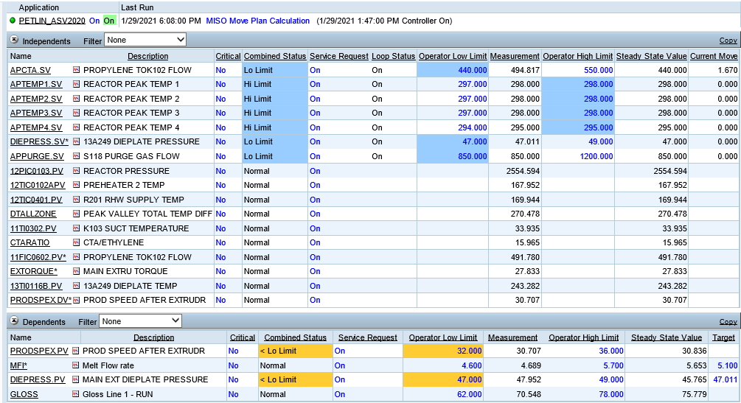
Web Viewer Overview
Desired MV limit operating range
Switch ON button for PETLIN_ASV2020
Calculated SS value by APC
Switch ON button for MV
Desired CV limit operating range
Switch ON button for CV
External target. The desired target by operator/GTM
Internal

Slide 16
Main Controlled Variables
Internal

Slide 17
a) Melt Flow Index and Diepress
One of the most important quality to be controlled is MFI. Significant difference for this APC revamp is, MFI will be controlled by Diepress.SV.
Diepress.SV is a dummy setpoint which will provide an external target to another CV, Diepress.PV. Diepress.PV will manipulate CTA flow.
Manipulated Variables (MV) | Controlled Variables (CV) | APC Controller Objectives
DIEPRESS.SV (Dieplate Pressure) | MFI (Melt Flow Index Analyser) | To control MFI at target (i.e. 5) as set by the operator or APR/TM. Main handle is die plate pressure. However, this is not a real controller. DIEPRESS.SV will be used as external target for DIEPRESS.PV.
 |  | MFI measurement is a predicted value based on unbiased prediction from an inferential model and bias update value. Mainly used all the time. MFI measurement is a predicted value based on unbiased prediction from an inferential model and bias update value.
 |  | Bias update is configured to receive input from 2 sources which are analyser (13AI0101) and lab measurement.
Manipulated Variables (MV) | Controlled Variables (CV) | APC Controller Objectives
APCTA (Propylene Flow) | DIEPRESS.PV (Die plate Pressure) | To control die plate pressure at its target and its target coming from DIEPRESS.SV (sent by APC)
 |  | Diepress measurement is a predicted value based on unbiased prediction from an inferential model and bias update value. Bias update is configured to receive input only from the filtered online dieplate measurement 13PI0107B_PVFLT.PV
Internal

Slide 18
a) Melt Flow Index and Diepress
Switch ON button for PETLIN_ASV2020
High and Low limit for its MV. It will be changed based on product grade either by operator or GTM
High and Low limit for MV will be similar with high and low limit for CV
Switch ON button for MFI CV
External target for MFI. Operator will key in the desired MFI target here. Source of inputs , either operator or GTM.
Internal

Slide 19
a) Melt Flow Index and Diepress
Ensure Diepress.SV service request is on every time APC is controlling MFI
High and Low limit for MV will be similar with high and low limit for CV
External target for Diepress.PV is coming from Diepress.SV
Internal

Slide 20
b) Gloss
Another quality to be controlled is Gloss. The quality will be controlled by Peak Temperature 1 / 2 /3 / 4 and purge gas flow. Purge gas flow is configured to be minimized all the time.
Manipulated Variables (MV) | Controlled Variables (CV) | APC Controller Objectives
APTEMP1 (Peak Temp Zone 1) | GLOSS (Gloss) | To control Gloss within limit as set by the operator or APR/TM. Main handle is Peak temperature.
APTEMP2 (Peak Temp Zone 2) |  | GLOSS is predicted value from inferential model. It is not used during high MFI (M022X & M050X) production.
APTEMP3 (Peak Temp Zone 3)
APTEMP4 (Peak Temp Zone 4)
11FIC0401 (Purge gas flow) |  | During gloss low limit violation, purge gas will be maximized and peak temperatures will be reduced
Internal

Slide 21
b) Gloss
For product grade without gloss quality, this CV will be turned off automatically by GTM
Gloss will be controlled between low and high limit configured by panel operator or GTM
Internal

Slide 22
c) Prodspex
Prodspex is controlled by Peak Temperature 1 / 2 /3 / 4 and purge gas flow where all the peak temperature are configured to be maximized and purge gas flow is configured to be minimized to maximize production
Manipulated Variables (MV) | Controlled Variables (CV) | APC Controller Objectives
APTEMP1 (Peak Temp Zone 1) | PRODSPEX (Production Rate) | To maximize production rate to its high limit as set by the operator or APR/TM. Main handle is Peak temperature.
APTEMP2 (Peak Temp Zone 2) |  | PRODSPEX is used all the time to optimize the production rate.
APTEMP3 (Peak Temp Zone 3)
APTEMP4 (Peak Temp Zone 4) |  | Purge gas will be set to be minimized to maximize Prodspex. During gloss low limit violation, purge gas and peak will be directly responding to gloss measurement due to lower SS Low rank (means higher priority) parameter configured for gloss than prodspex.
11FIC0401.PV (Purge gas flow) |  | This is configured due to both CV (gloss & prodspex) are utilizing the same handles
Internal

Slide 23
c) Prodspex
Prodspex will be turned ON all the time to ensure production maximization.
Prodspex will be controlled between low and high limit . APC will try to bring to high limit.
Internal

Slide 24
How to operate APC
Checklist before turning ON APC.
Plant is running at normal and stable condition.
Check and verify lab readings for MFI & Gloss.
Inferential is updated with latest APC QC Lab result for MFI & Gloss.
Ensure that you know what quality you are targeting for. (i.e. MFI for specific grade)
Check the mode of your MVs. Ensure that it is in Auto mode. (APTEMP1, APCTA, APPURGE etc)
Check your MVs and CVs Operating Limits on PCWS. Make sure you know where are you operating.
Make sure you know the operating limits (Product Recipe) and what do you want to target for before you turn on the controller
Ensure Diepress.SV and Diepress.PV are turned ON to allow MFI is controlled by APC.
Ensure the high and low limit of Diepress.PV is within the recommended limit. Please refer to table on page 28.
Ensure alarm annunciator for watchdog has been acknowledged (if there is) before turning ON APC.
Ensure MFI and gloss measurement are within the APC limit. Please note that if the step is not done, it will drive the controller to wrong direction.
Internal

Slide 25
How to operate APC
How to turn ON APC
Check MFI/Gloss reading. Compare with reference reading (Lab/ Analyzer). Check process operating condition and operating limit for MVs and CVs.
Upload Lab result if required to update the inferential. It is advised to turn ON APC only after lab bias is updated
Turn ON PETLIN_ASV2020. Watchdog will reset automatically.
Adjust MV lower and upper operating limit
Adjust CV lower and upper operating limit
Turn ON MV switch.
Turn ON CV switch.
Key in Target for MFI.
3
6
4
7
5
8
Internal

Slide 26
How to operate APC
How to turn OFF APC
Turn OFF all MVs via service request
Turn OFF APC on PCWS
2
1
Internal

Slide 27
How turning ON APC when MFI not in APC limit could destabilize the process
How CTA movement is restricted due to constrained dieplate pressure
MFI High limit
MFI Prediction
MFI Lab sample
CTA Flow
Dieplate Pressure
MFI Low limit
APC ON
MFI High limit
MFI Prediction
MFI Low limit
TRIVIAL QUESTION:
If this happens, what should be done? Why?
Dieplate Pressure
CTA Flow
APC ON
Internal

Slide 28
Diepress Low and High Limit
Grade | Lo Limit | High Limit | Remarks
N103X | 69.3 | 70.5 | Best Dieplate range* to attain and average mfi range of 0.3
N109X | 59.19 | 62.20 | Dieplate Range - Historical Data 2020
N125Y | 54.5 | 56.5 | Best Dieplate range* to attain and average mfi range of 2.5
C170X | 49.29 | 53.35 | Dieplate Range - Historical Data 2020
C150Y | 46.5 | 48.00 | Best Dieplate range* to attain and average mfi range of 5.0
M022X | 37.5 | 39.00 | Best Dieplate range* to attain and average mfi range of 22
M050X | 26.81 | 29.64 | Best Dieplate range* to attain and average mfi range of 50
* Dieplate range is observed to vary according to the production rate running even of the same grade. A higher production rate will observe a higher dieplate range even at the same MFI value.
Internal

Slide 29
APC / DCS Internal Logic & Calculation
Internal

Slide 30
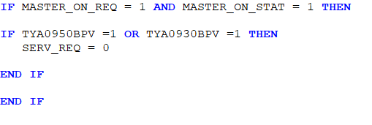
APC Internal Logic Calculation
There are few logics has been formulated in the calculation section. Basically, these logics are made in order to ensure smooth APC operation once commissioned. Below are some examples of logics configured
1) APTEMP4 MODE: This logic is to switch off MV APTEMP4 whenever peak temperature 4 is taken over by the override controller TIC0333A
Internal

Slide 31

APC Internal Logic Calculation
2) APCTA_PVTRACK: This logic is to ensure, whenever APC is OFF, the measurement will follow the current value. Thus, there is no bump whenever APC is turned ON. The same logic is duplicated for other MVs (APTEMP1/2/3/4_PVTRACK, DIEPRESS_PVTRACK, APPURGE_PVTRACK) and CV target (MFI_TARGET_TRACK, DIE_TARGET_TRACK)
Internal

Slide 32

APC Internal Logic Calculation
3) APTEMP1_AWC: This logic is to prevent huge difference between current DCS value to the setpoint given by APC. When the difference greater than the factor configured, APC will restrict the MV setpoint from increase or decrease by changing the status at AWS. The same logic has been configured for other MVs. The factor can be changed by APC engineer through PCWS and it is in engineering unit.
The example below is for DIFFTEMP
Variables | AWC factor in PCWS
APCTA | 20 kg/hr
APTEMP1/2/3/4 | 3 degC
APPURGE | 25 kg/hour
Internal

Slide 33
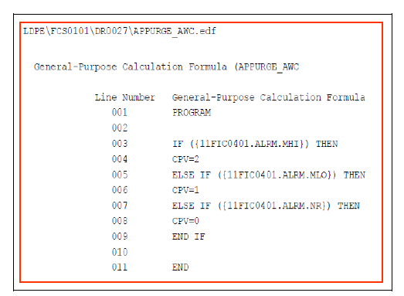
DCS Internal Logic Calculation
4) APC Wind Up:
To tell APC controllers the status of PID controllers when its output reaches 0% or 100%. Final element fully close or fully open. (i.e. 11FIC0602.MV, 12TIC0720.MV). In the logic as per snapshot below, the trigger limit is the high and low clamp (MHI,MLO)
The status of Anti Wind-up is displayed on DCS and Web Viewer
Internal

Slide 34
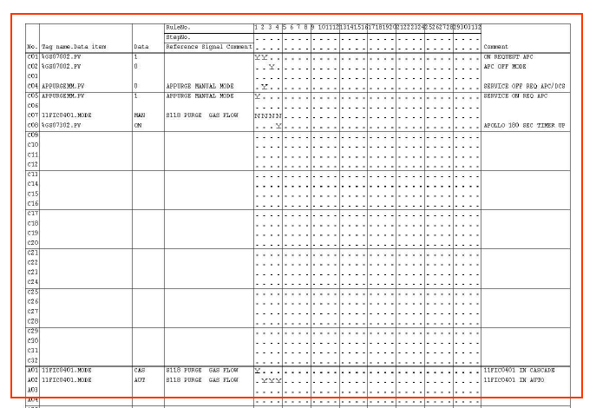
DCS Internal Logic Calculation
5) Shed Mode:
The shed mode logic is required to return all of the PID controllers to their normal modes (e.g., “AUTO” for CTA and Peak Temperature controls) when the APC shuts down or when an individual MV is taken out of control. If the APC is turned ON, the DCS logic must change the modes of the PID controllers whose MVs are required to be ON, to the required DCS mode (CAS).
Internal

Slide 35
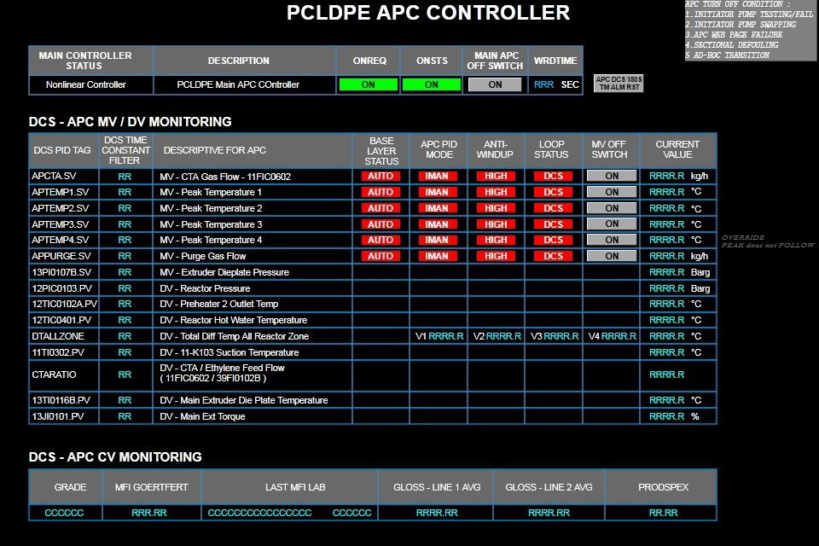
DCS Internal Logic Calculation
6) Watchdog Update: Annunciator added if 180 seconds timer up.
If Watchdog timer is up (180seconds) a message will be sent to DCS annunciator on communication fails. APC will not be able to switched on, if alarm reset button is not acknowledged.
Hidden Reset Alarm Button
Internal

Slide 36
DCS Internal Logic Calculation
7) APC switch off button at DCS
New DCS APC page allows for panel to switch off MV’s or APC Main controller. Approximate 1-2 minute delay for the status to reflect at APC PCWS. However, status at DCS shall be immediate. Switch ON is allowed only through PCWS.
New Switch Off Button
Internal

Slide 37
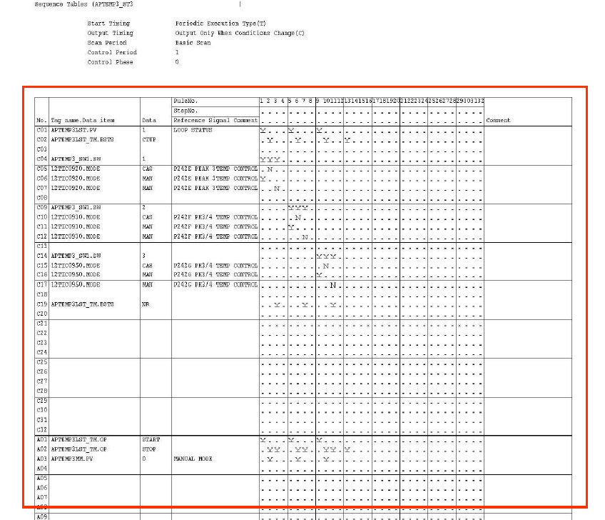
DCS Internal Logic Calculation
8) Base Layer Status (MAN) during APC MV is On (ST3)
A new sequence table for Loop Status Timer is created for all MV’s whereby, if MV Loop Status is in APC, however Base layer is in Manual for more than 420 seconds, DCS will send off request to update the loop status. This is to cater for response test activity.
Internal

Slide 38
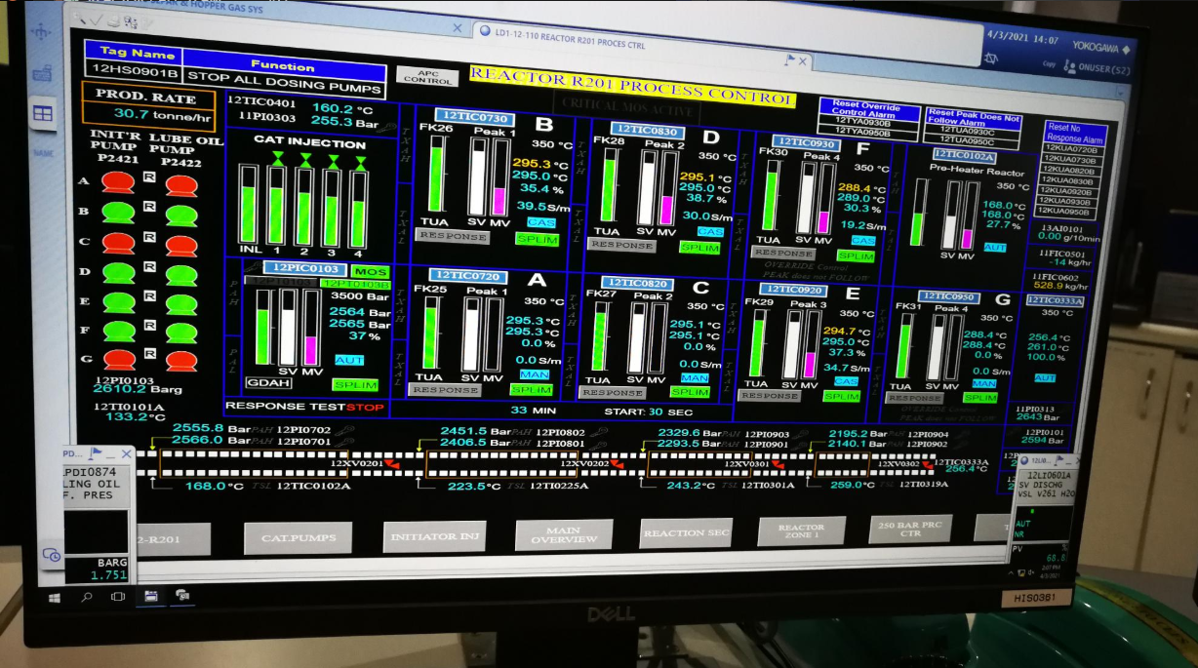
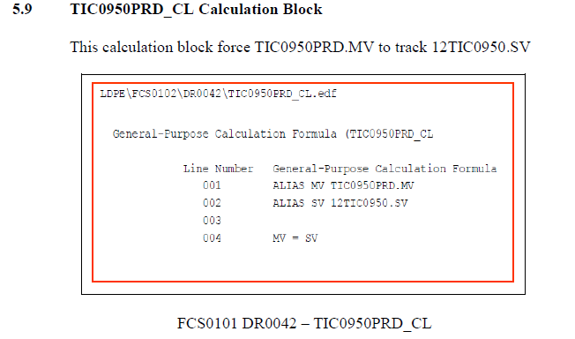
DCS Internal Logic Calculation
9) TIC0950PRD_CL Block Fix – Pump F (APC Running)
This block is a calculation block which was used in initial DCS response test. Based on system check, the last time the block was used in 2003. This block causes for for sudden peak drop during running Pump F due to the MV value was last updated to 173. Tracking the block value to actual current SV prevents the peak temp dip during running Pump F with APC Online.
Internal

Slide 39
Inferential Quality
Internal

Slide 40
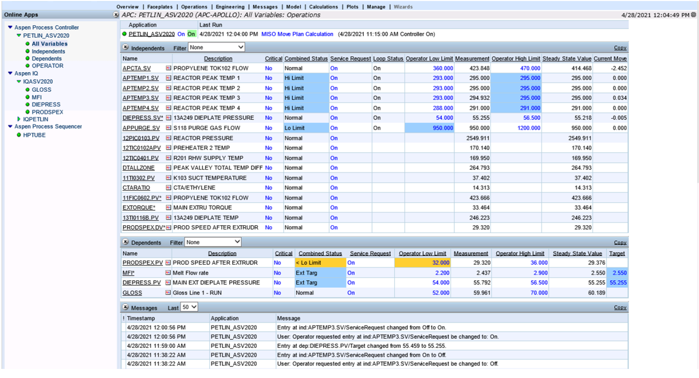
Inferential Quality (IQ)
There are 3 inferential have been developed and used directly as a measurement to APC. They are MFI and Gloss. Another one inferential , Diepress is used as one of the inputs to to MFI.
Internal

Slide 41
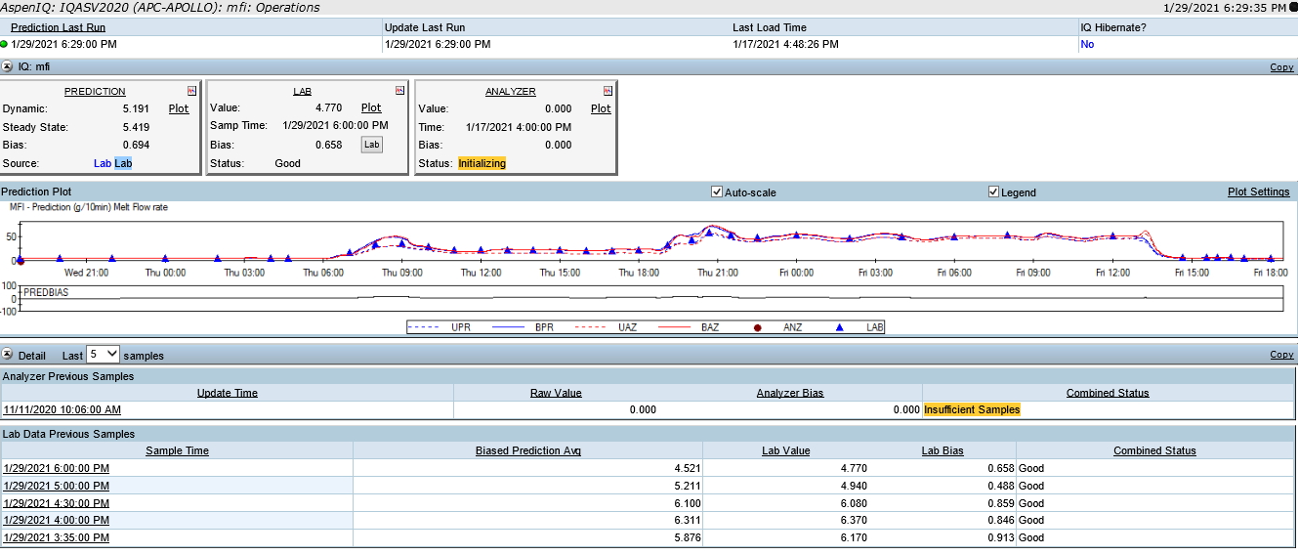
MFI Inferential
asdas
Internal

Slide 42
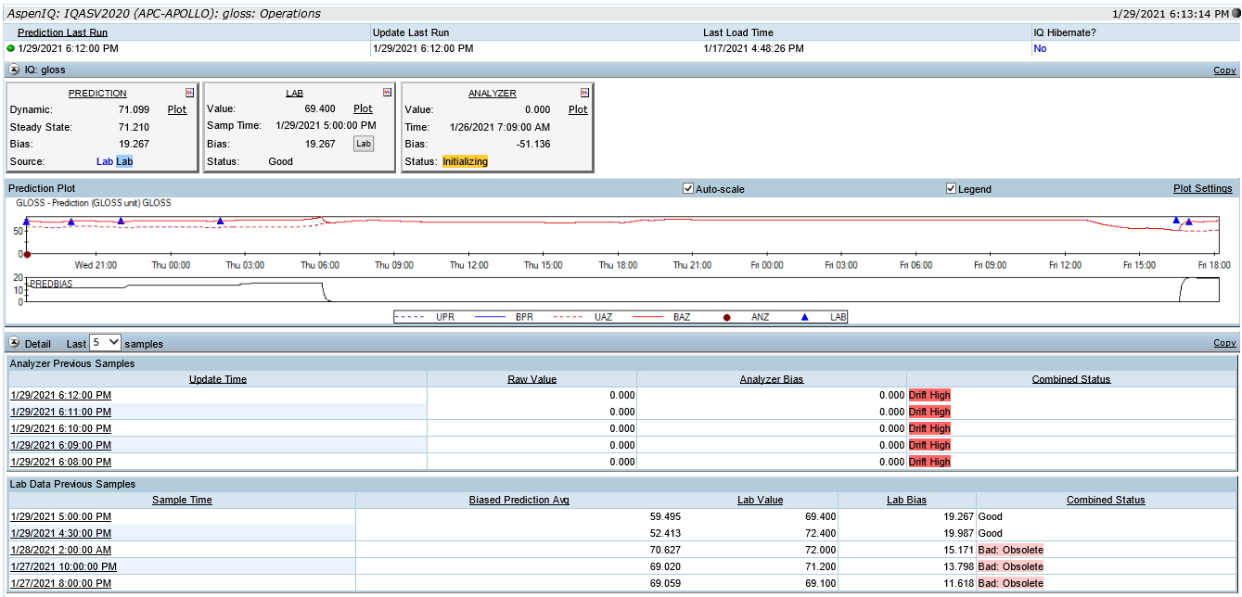
Gloss Inferential
asdas
Internal

Slide 43
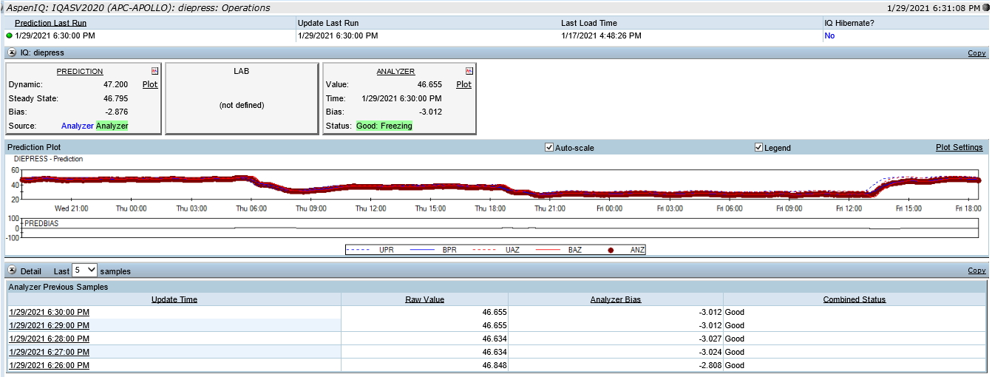
Diepress Inferential
Internal

Slide 44
Inferential Quality (IQ)
Lab Update
The following steps are crucial for APC to drive to correct solution:
  It is important to load APC QC lab result at least every 4 hours to update the inferential.
  Ensure that the lab data is correct before you update them into the model. Otherwise, it will give you bad prediction.
  Ensure that the APC QC lab data is collected at consistent time interval. Record the time of sample taken correctly & accurately!
  Ensure that you key in the correct time and lab value into Web Viewer. Please ensure there is no typo error!
  After the latest QC lab data is keyed in, you cannot key in the QC lab data which has already lapsed.
  If inferential update is not done, APC will not be able to correct the error (Bias Update) between the inferential prediction and actual value. This will give you bad prediction.
  You need to check the lab bias on web viewer to make sure that it is consistent.
  If 2 consecutive lab result sample is nearing product spec limit/off spec, directly to inform APC Focal for further assessment. Why?
Internal

Slide 45
Inferential Quality (IQ)
Analyzer Update
The following steps are crucial for APC to drive to correct solution:
  Operator to check analyzer status is good at Analyzer module in PCWS.
  Always counter check analyzer reading with lab result to ensure its accuracy.
  If the error between analyzer and lab reading is more than 5%,please request additional lab sample to confirm the reading.
  If it is consistent, please change the update source to lab.
  During preventive maintenance activity on the analyzer, please use lab reading as update source.
Internal

Slide 46
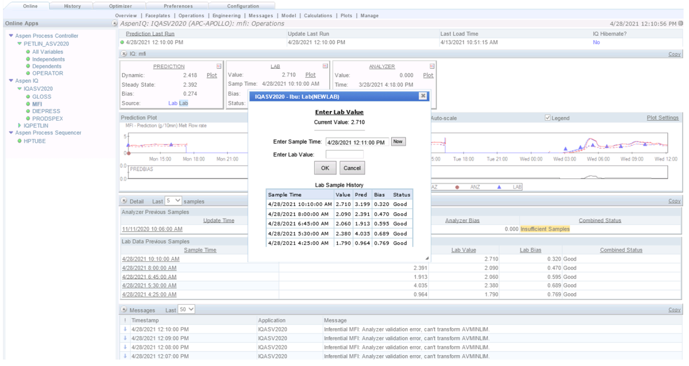
How to update inferential lab measurement
Go to IQ ASV2020
1
Select Lab tab and click “LAB” button
3
2
Select MFI
4
Key in the time and Lab value
Internal

Slide 47
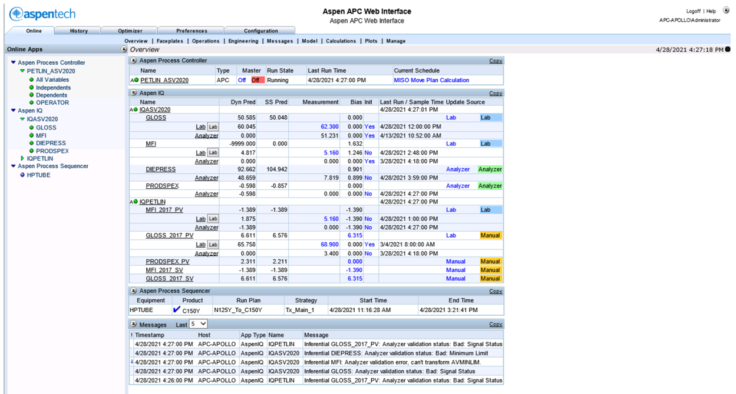
How to update inferential lab measurement via Overview Tab
1
Go to Overview tab
2
Click at the “LAB” button
Internal

Slide 48
Grade Transition Manager
Internal

Slide 49
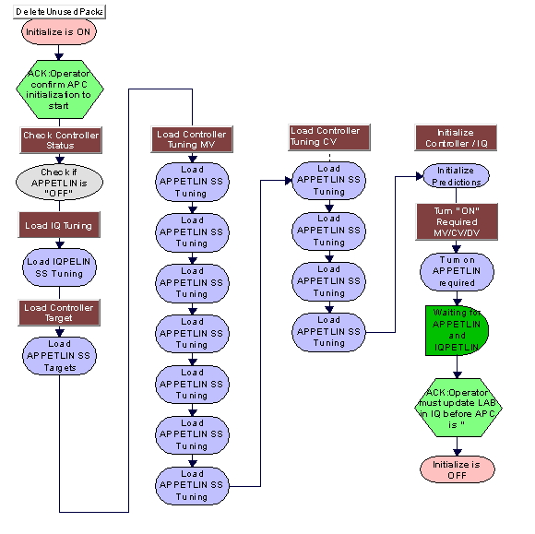
Grade Transition Manager : Grade Initialization
Aspen Process Sequencer View
Initialization:
Internal

Slide 50
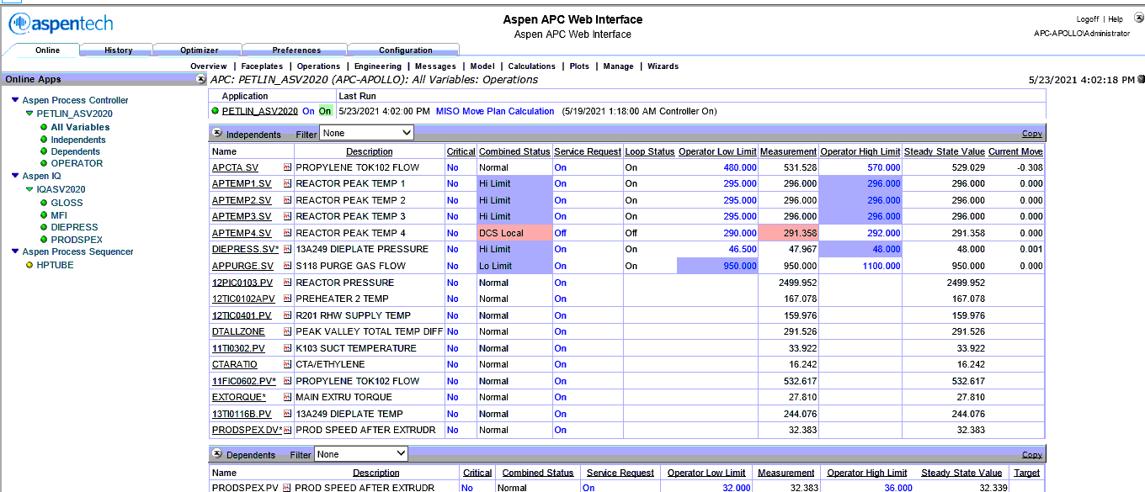
Grade Transition Manager :
How to perform Grade Initialization
Aspen PCWS View
1
Click on HPTUBE
Internal

Slide 51
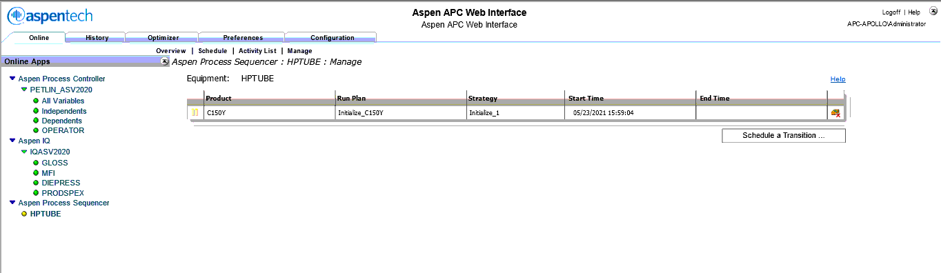
Grade Transition Manager :
How to perform Grade Initialization
Aspen PCWS View
2
Click on Manage
3
Click to delete any existing run plan
Internal

Slide 52
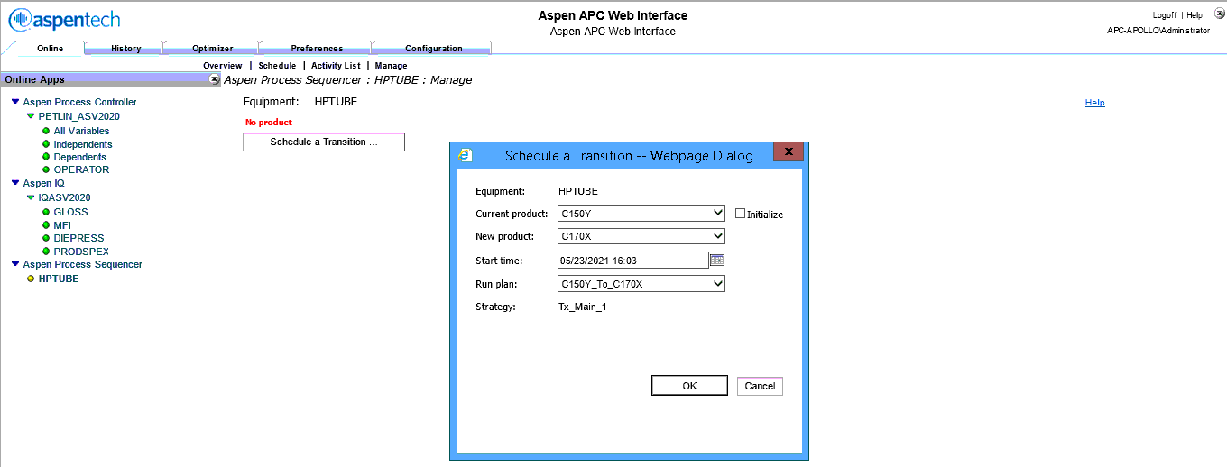
Grade Transition Manager :
How to perform Grade Initialization
Aspen PCWS View
4
Click on Schedule a Transition
5
Select Grade to Initialize
6
Click on Initialize Box
Click on OK button
7
Internal

Slide 53
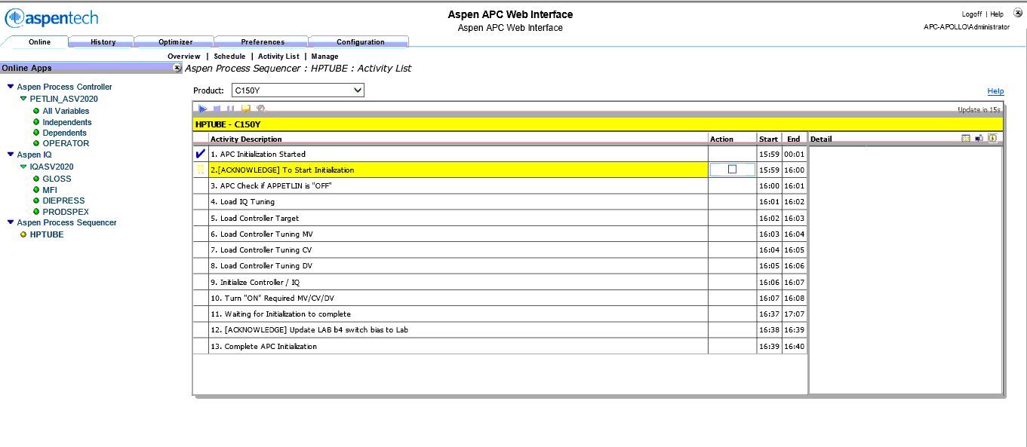
Grade Transition Manager : Grade Initialization
Aspen PCWS View
8
Click on to acknowledge grade initialization
9
Click on to complete initialization
What condition requires grade initialization:
After Manual Transition & After Plant Start-up
When to start initialize Grade: After swing to prime silo
Internal

Slide 54
Grade Transition Manager : Grade Initialization
Aspen PCWS View
Hands-on Exercise
The following are actual exercise for actual grade initialization
  Hands-on Exercise 1:
    Pre-requisite: APC System is already online
    Activity: Start grade initialization (same grade to initialize is also allowed)
    Queries: Can the initialization be completed?
  Hands-on Exercise 2:
    Pre-requisite: APC System is OFFLINE (Turn APC Off temporarily if required.)
    Activity: Start grade initialization (same grade to initialize is also allowed)
    Queries:
      Can the initialization be completed?
      What parameter do you observed has been updated?
Internal

Slide 55
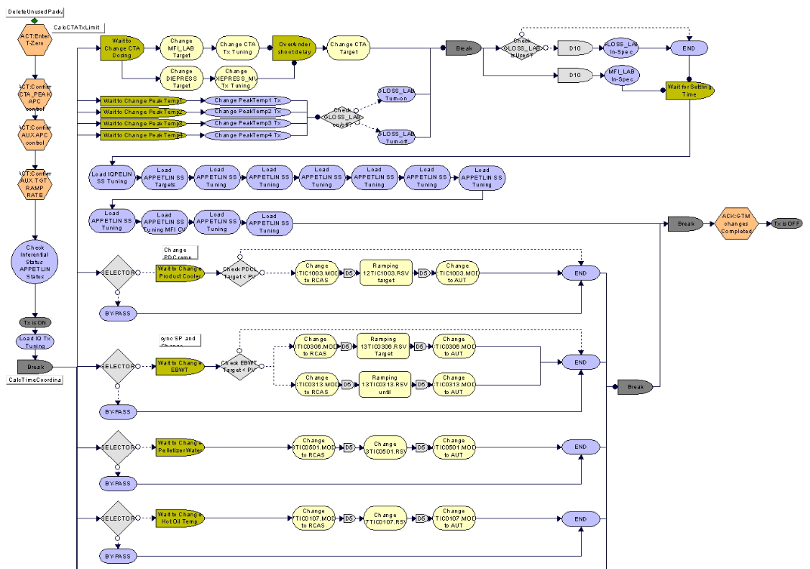
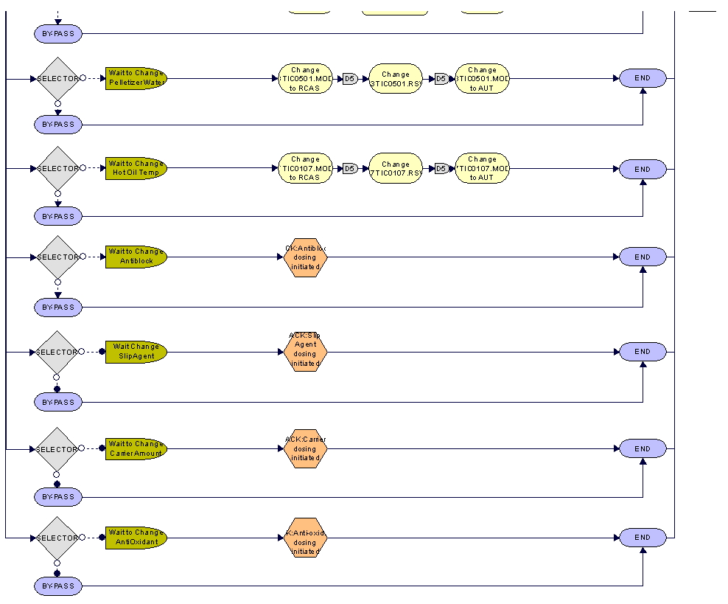
Grade Transition Manager: Main Transition
Aspen Process Sequencer View
Section A
Section C
CTA Overshoot -
Peak Change -
Prodspex /Gloss On-Off -
- MFI / Gloss Quality check after overshoot
- Load of APC steady state parameters (limits/tunings)
Section B
Product Cooler Ramping
Extruder Barrel Water temp Ramping (13TIC0306)
Extruder Barrel Heater Ramping (13TIC0313)
Pelletizer Water
Product Cooler SV change
Hot Oil SV Change
Acknowledgement button of Additive change
Internal

Slide 56
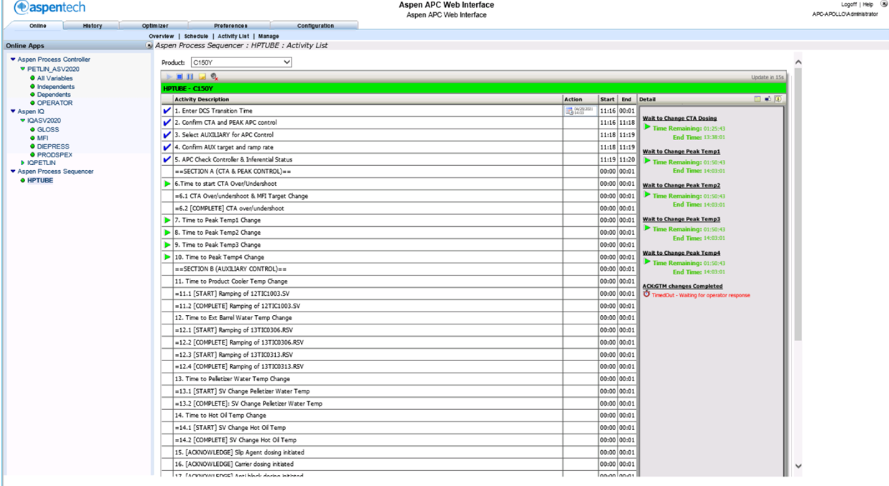
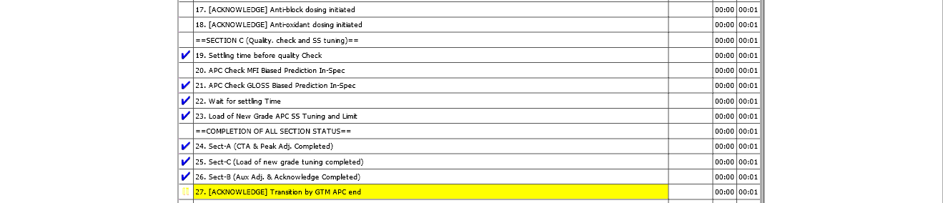
GTM Activity List in PCWS
Aspen PCWS View
Section A
Section B
Section C
Internal

Slide 57
PETRONAS
Passionate about Progress
Internal

Slide 58
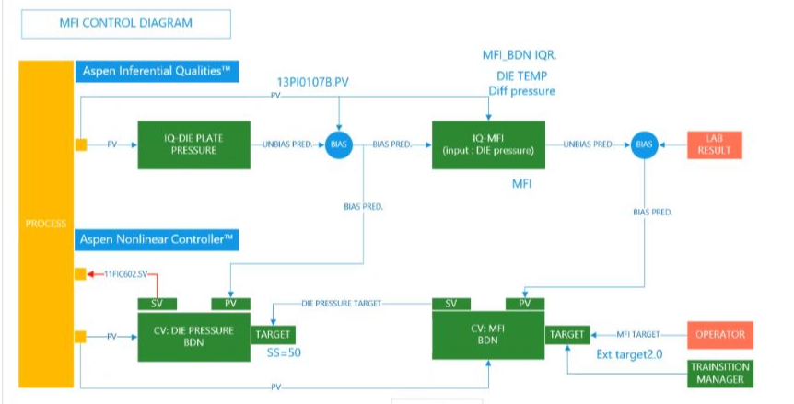
Drawing
How deviation of lab reading and current cv haywire
The MFI control mechanism
MFI High limit
MFI Prediction
MFI Lab sample
CTA Flow
Dieplate Pressure
MFI Low limit
APC ON
Internal

